Slide 1

Expansion to the Brazilian Market with Magist?
Louise Dädlow, gmldaed@posteo
Naeimeh Sharghivand, na.sharghivand@gmail.com

Slide 2
Main Concerns
Is Magist a good fit for high-end tech products?
Are orders delivered on time?

Slide 3
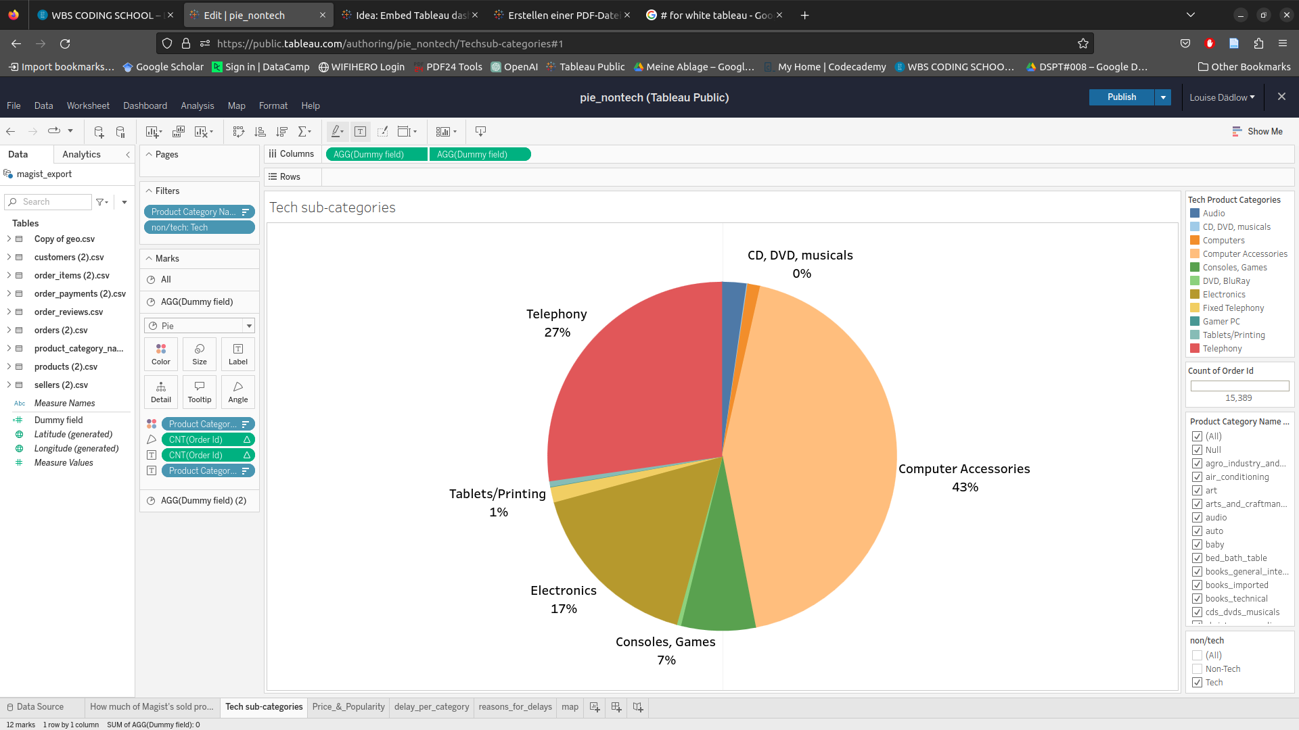
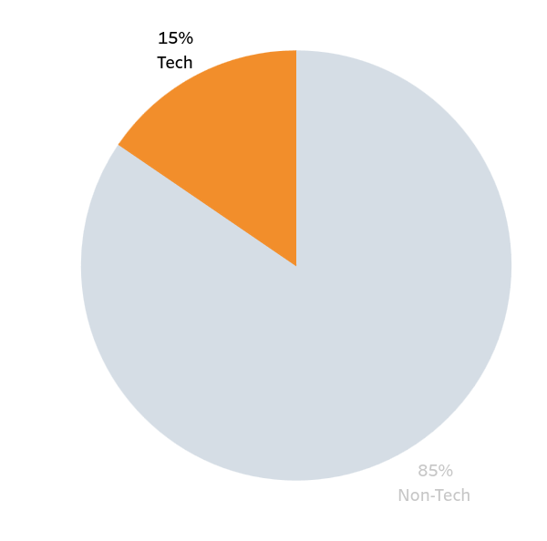
Who Is Magist?
Sales in 2016-2018

Slide 4
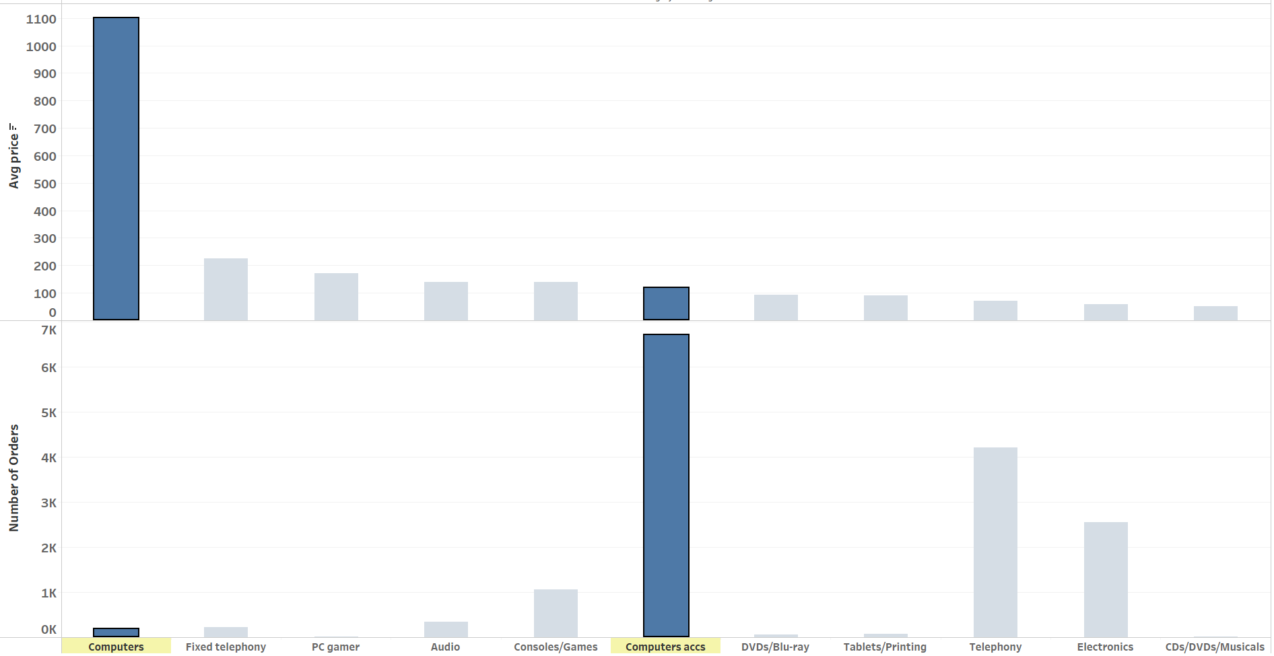
Who Is Magist?
Sales in 2016-2018

Slide 5
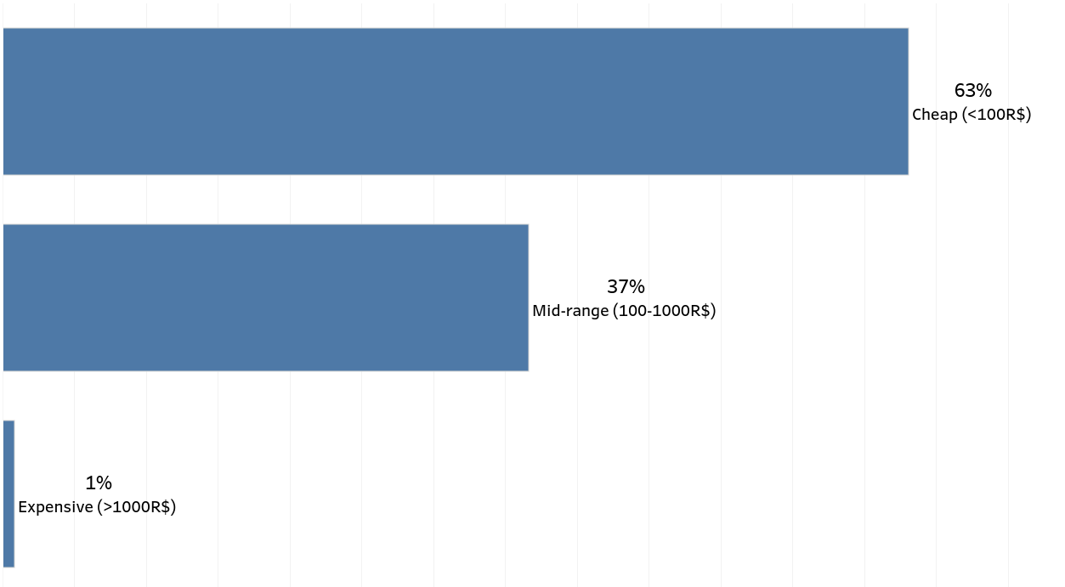
Are Expensive Tech Products Popular?

Slide 6
Magist Delivery Performance
Average delivery time in Brazil is 10 days
Customers expect no more than 6 days
Average delivery of Magist 12 days
percentage of delayed parcels is 7%
Study on E-commerce Brazil

Slide 7
Expansion to the Brazilian Market with Magist?
Magist mostly sells cheap tech products (<18€).
Delivery time of Magist’s products is higher than Brazilian customers’ expectations.

